Slide 1

CDR
Lazy Bob - SDP23 Team 5
Omar Areiqat, Vedatman Basu, Redwan Rahman, Jina Song
Notes:
Gina

Slide 2
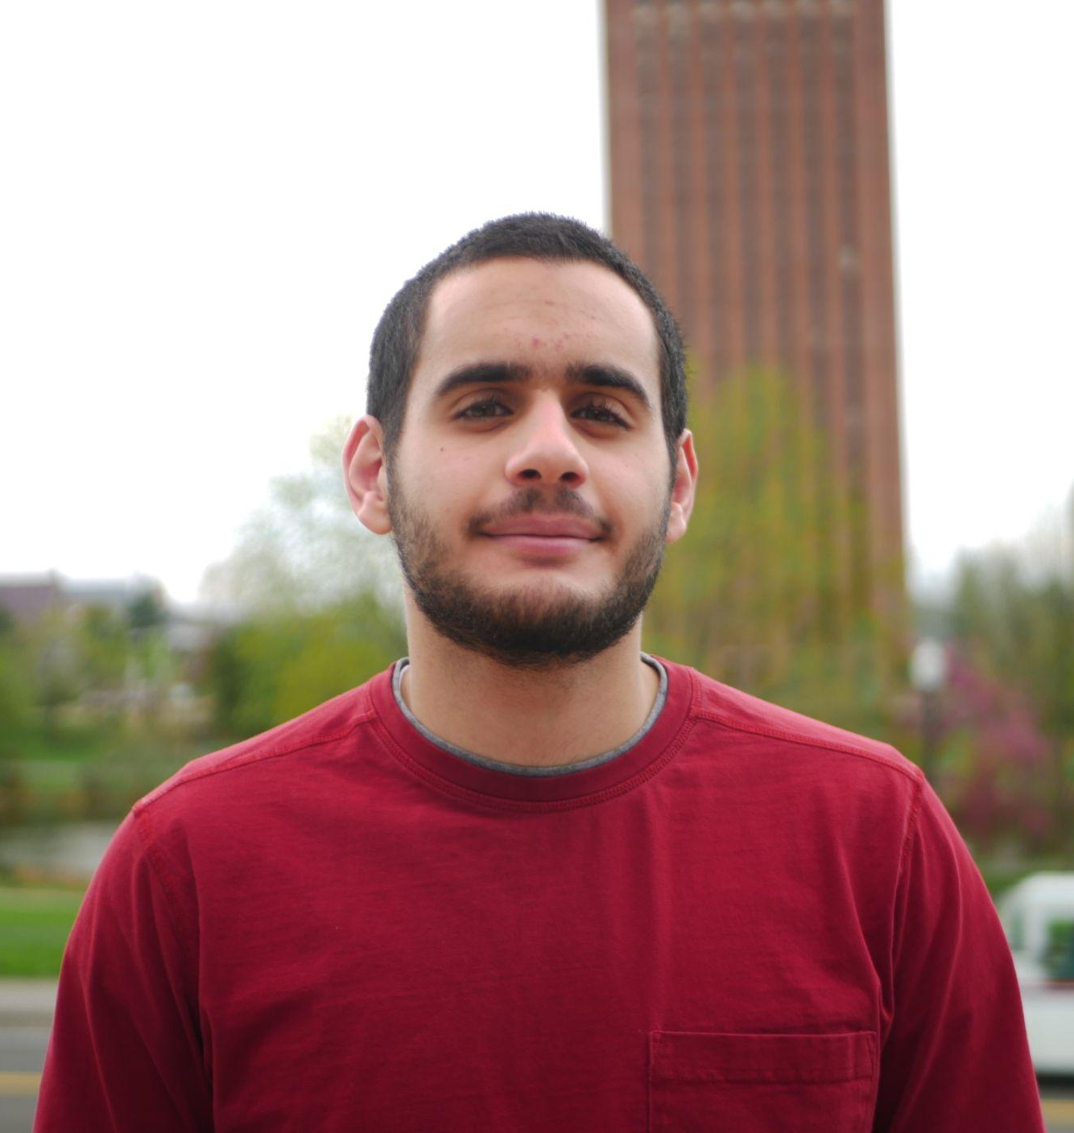
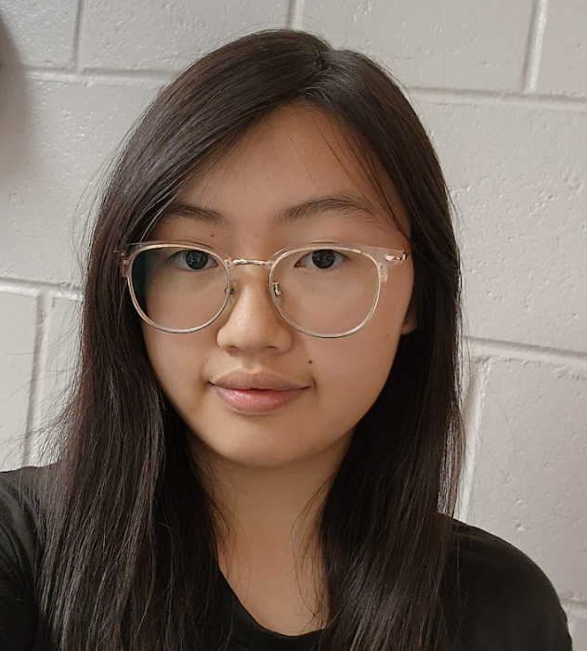



The Team
Omar Areiqat
CompE
Budget Lead
Movement and Power
Jina Song
EE
PCB Lead
Design
Vedatman Soham Basu CompE
Software Lead
Sensors
Redwan Rahman
CompE
Logistic Lead
Positioning
William Leonard
Advisor
Notes:
Individual

Slide 3
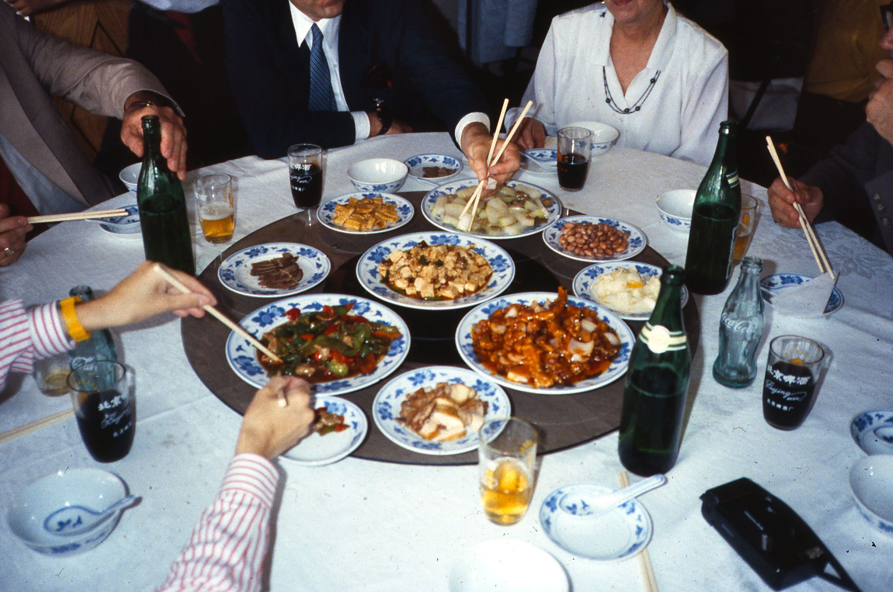
Problem Statement
Some people struggle with mundane actions in life, such as passing dishes on a large table.
Lazy Susans are nice, but only work on round tables and requires user to have reach.
What if there was a small, portable device that can move dishes across any table of arbitrary shape?
https://en.wikipedia.org/wiki/Lazy_Susan
Notes:
Soham

Slide 4
Our Solution
“Lazy Bob”: A moving coaster that approaches the user when called.
Stably transport items around a table to different users
Provide a simple way to interface with all coasters
Adapt to the environment
Notes:
Gina

Slide 5

Purple: Caller
Yellow: Random Object
Plate 2
Coaster
Coaster
Coaster
θ
Coaster
Coaster
Coaster
Plate 5
r
Plate 1
HQ
Plate 3
Plate 4
Notes:
Gina

Slide 6
Functional and Design Specification

Slide 7
System Specifications: Functional
Mostly full container of liquid doesn’t spill when moving
Transport items without the items falling off
Detect the edges of the table and avoid falling off
Avoid objects that are in the coaster’s moving path
Arrive at the caller to an accuracy of 10 cm from the edge of the coaster
Support up to 3 lbs.
Test Plan
Place an 80% full glass/bowl of water and visibly check that the moving coaster doesn’t spill
Put objects on moving coaster and watch if object falls
Watch if the moving coaster falls off when caller is away from the table
Put objects in path and check if moving coaster bumps into object
Use a tape measure to check the distance from destination
Place an object that weighs 3 lbs and check if system is stable while moving
Notes:
Soham
- briefly point out, reminder from pdr

Slide 8
System Specifications: Design
Test Plan
7. Press both callers and see if the coaster follows
first-in, first-out sequence
8. Use tape measure to check coaster size
9. Find and put on irregular shaped tables and check
if they fall off
10. Line up objects to allow no path to caller, see if
system notifies caller
7. System supports at least 2 callers at the same
time
8. Coaster diameter is within 30 cm
9. Be able to use the moving coaster regardless of
table shape
10. If no path to caller is available, indicate to caller
Notes:
Soham

Slide 9
Block Diagrams

Slide 10
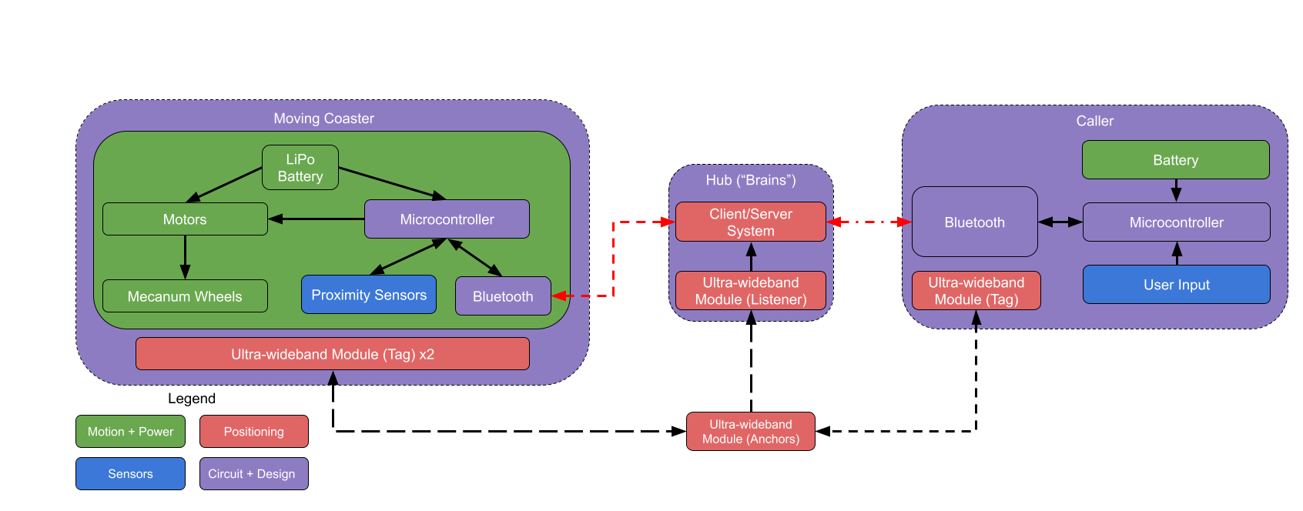
Hardware Block Diagram
Notes:
Gina, Explain changes more - show previous ?

Slide 11
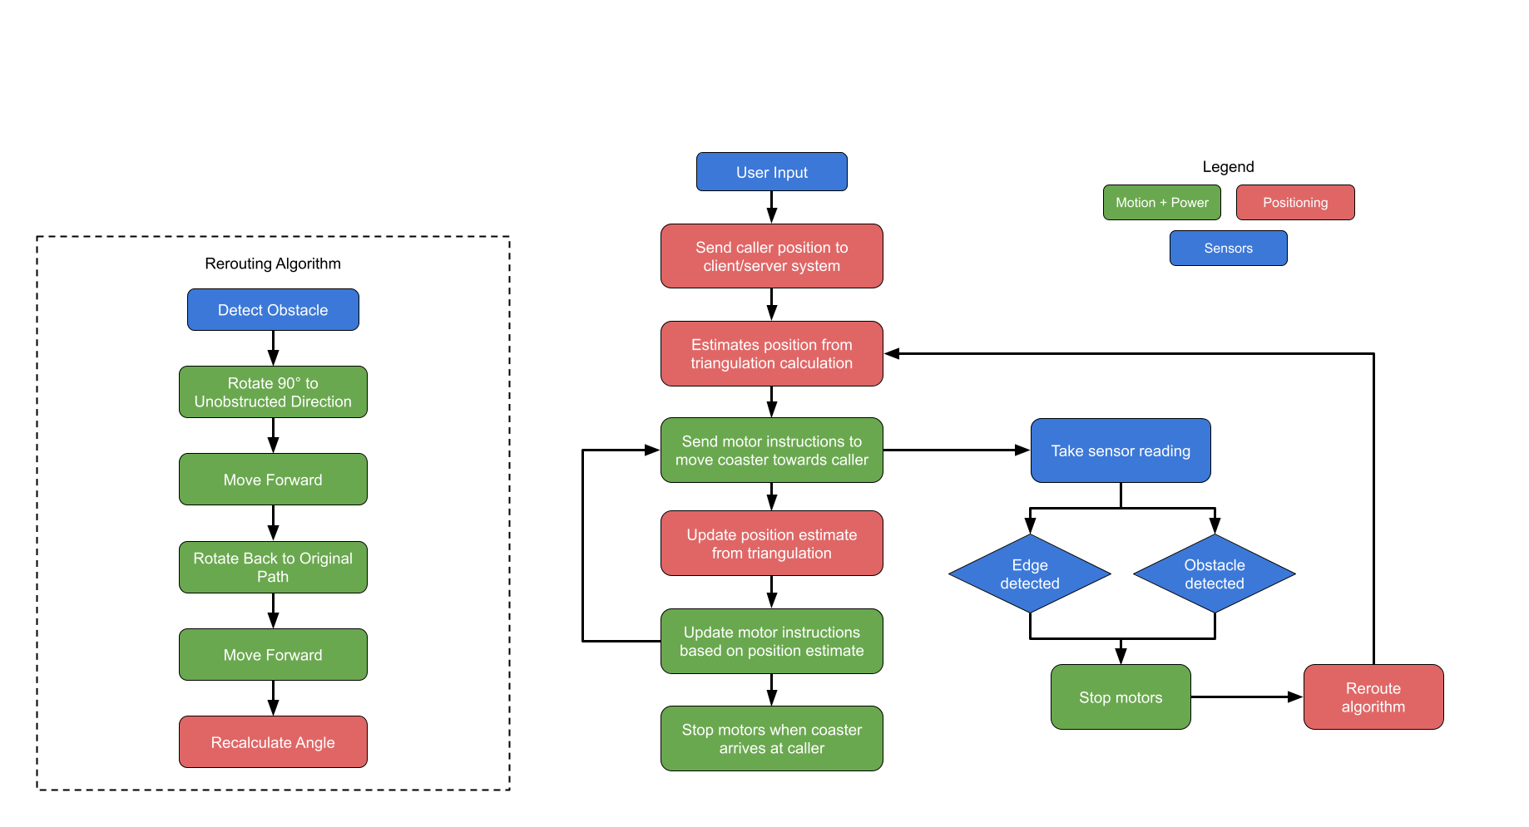
Software Block
Diagram
Notes:
Redwan
- The position updating and ultrasonic sensor happens in parallel Remove purple Reroute algo - stuff New block diagram?

Slide 12
System Hardware

Slide 13
Coaster

Slide 14
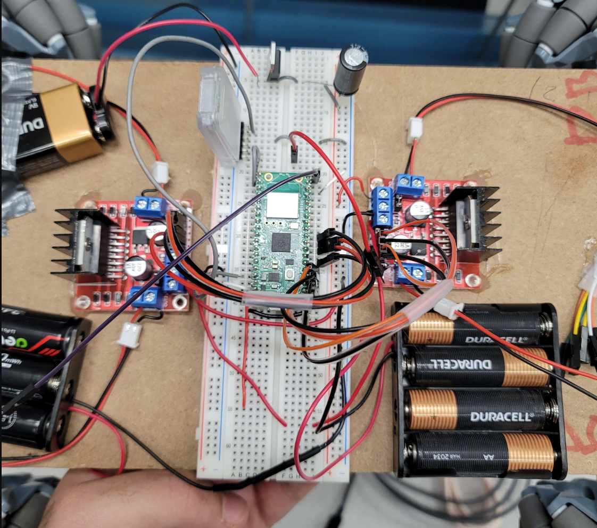
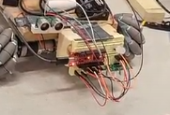
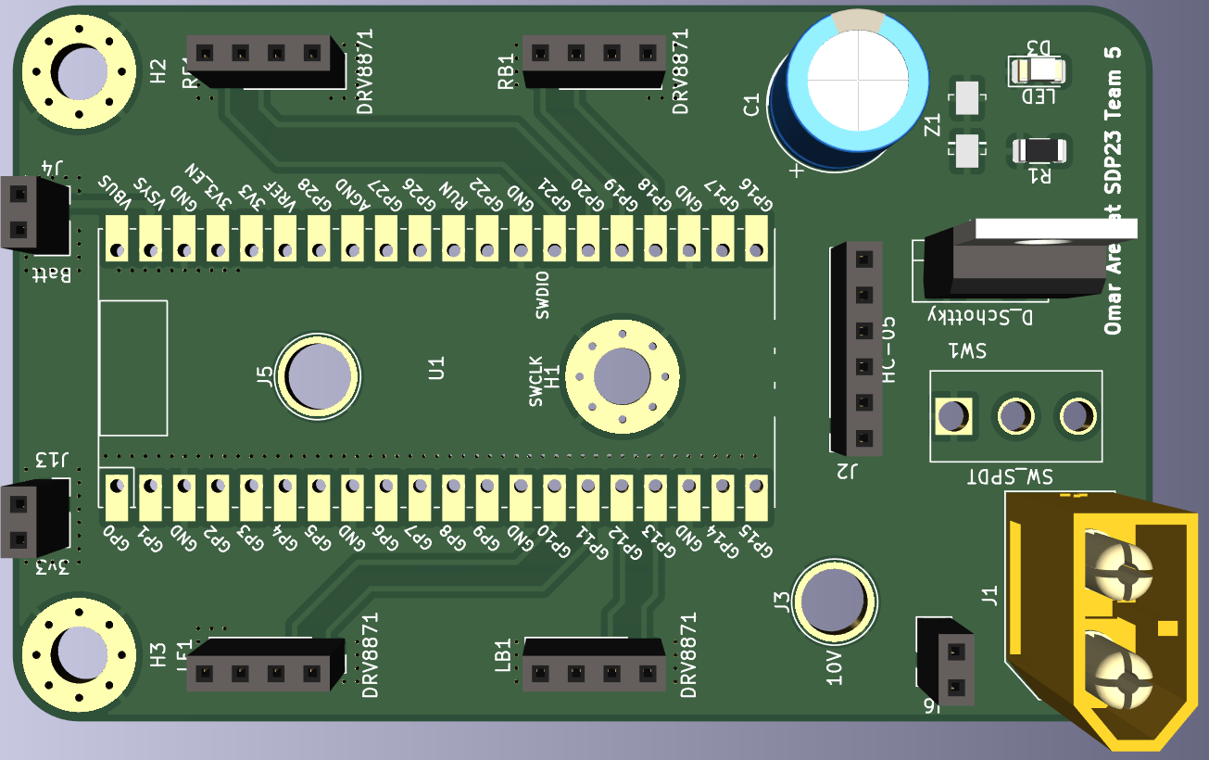
Coaster: MDR

Slide 15
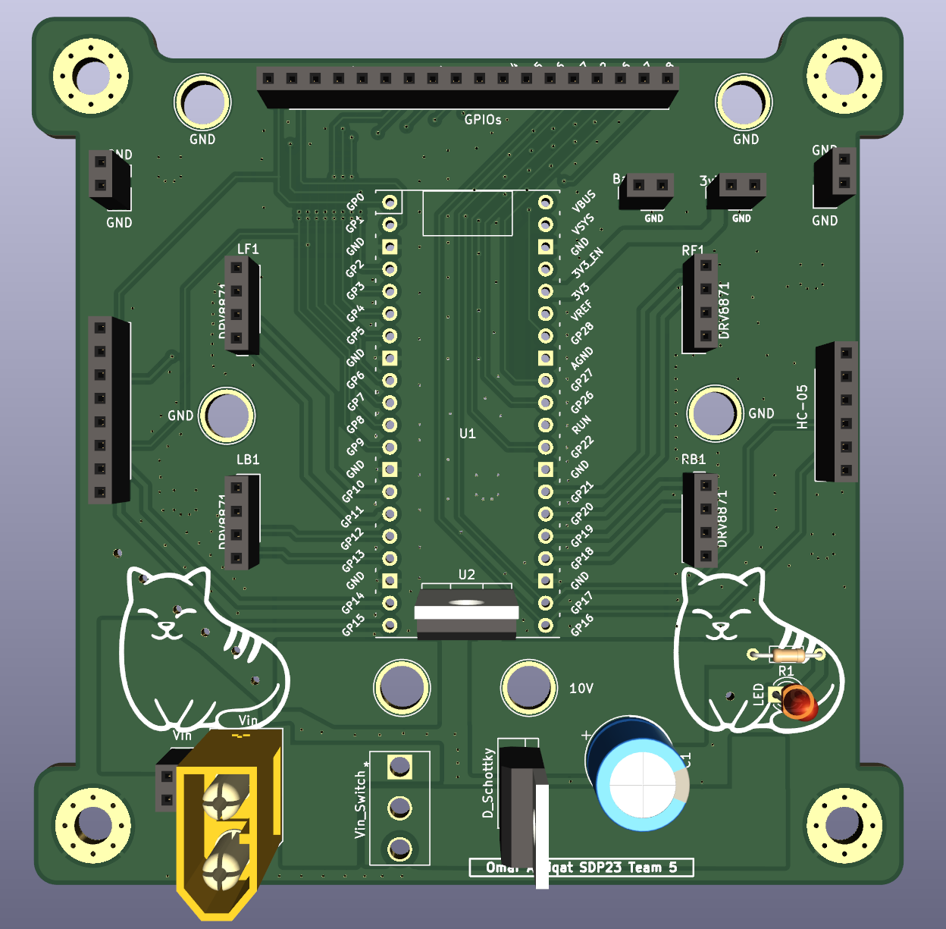
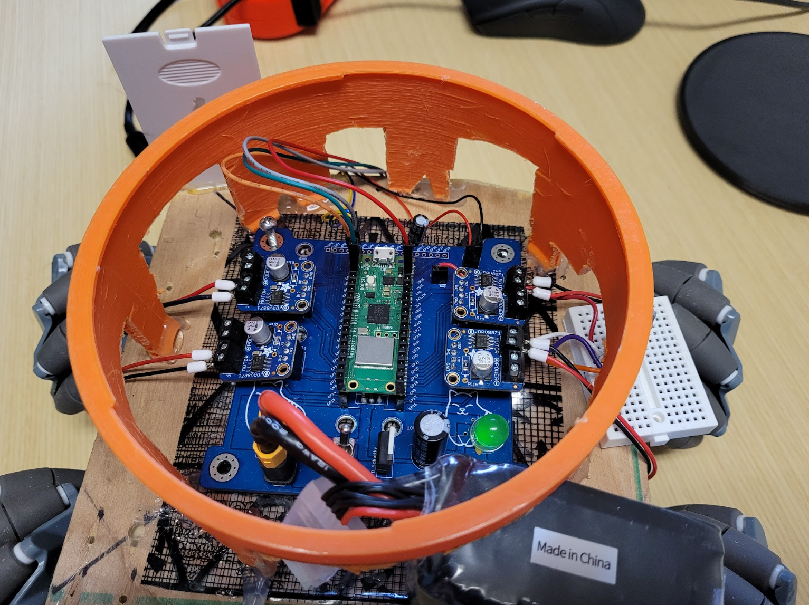
Coaster: CDR
Notes:
Omar
Show old system picture / pcb

Slide 16
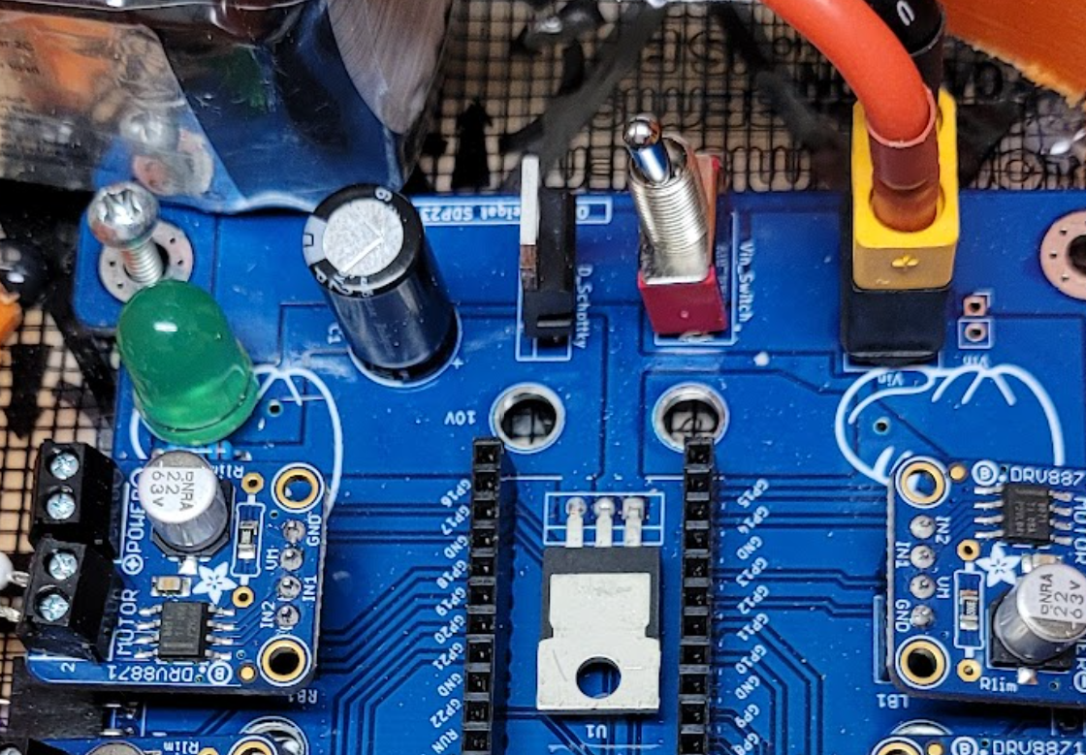

Slide 17
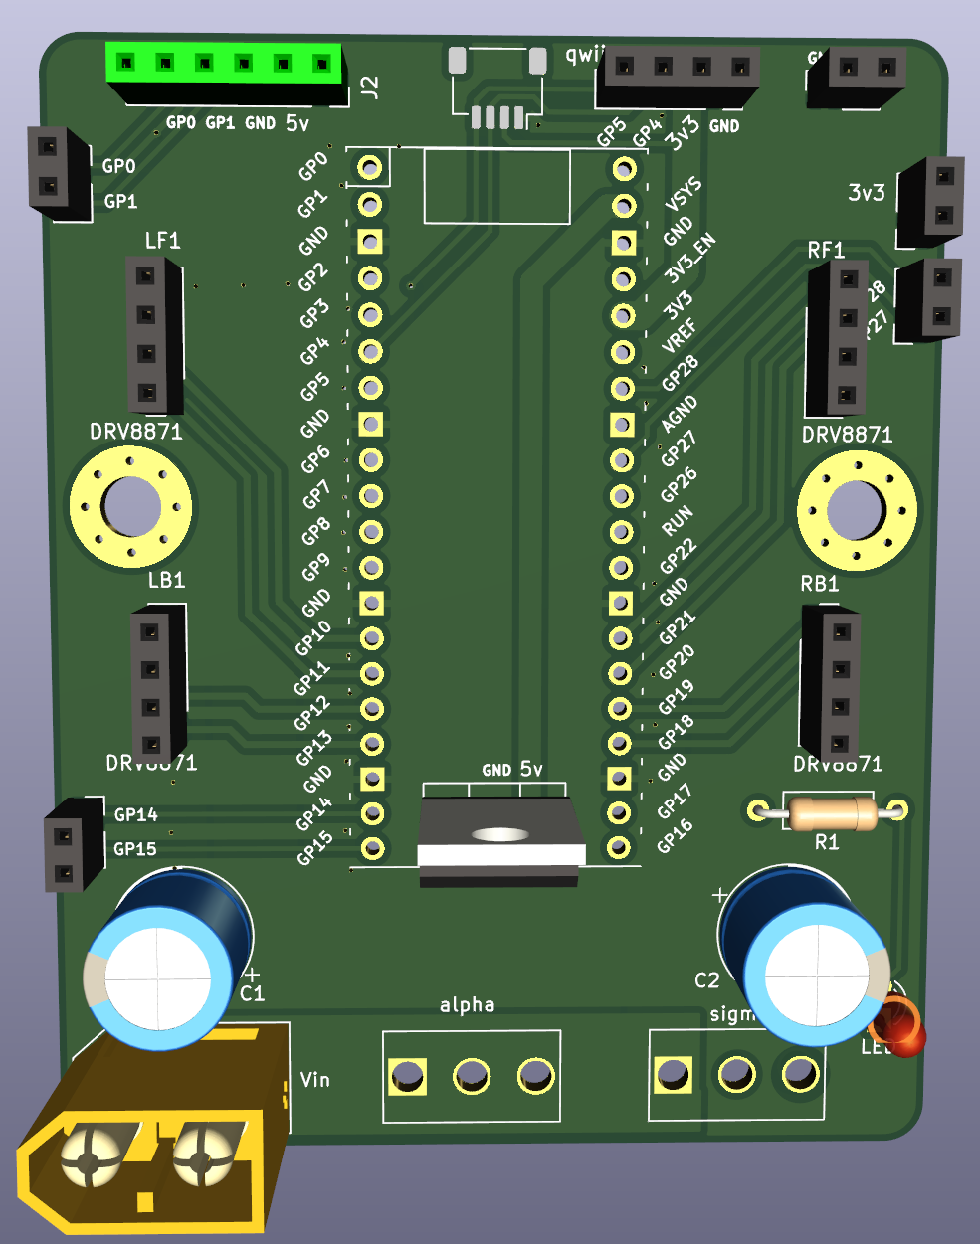
Coaster: FPR PCB
Notes:
Omar Better transition to this slide
Show previous / current / future pcbs

Slide 18
Caller

Slide 19
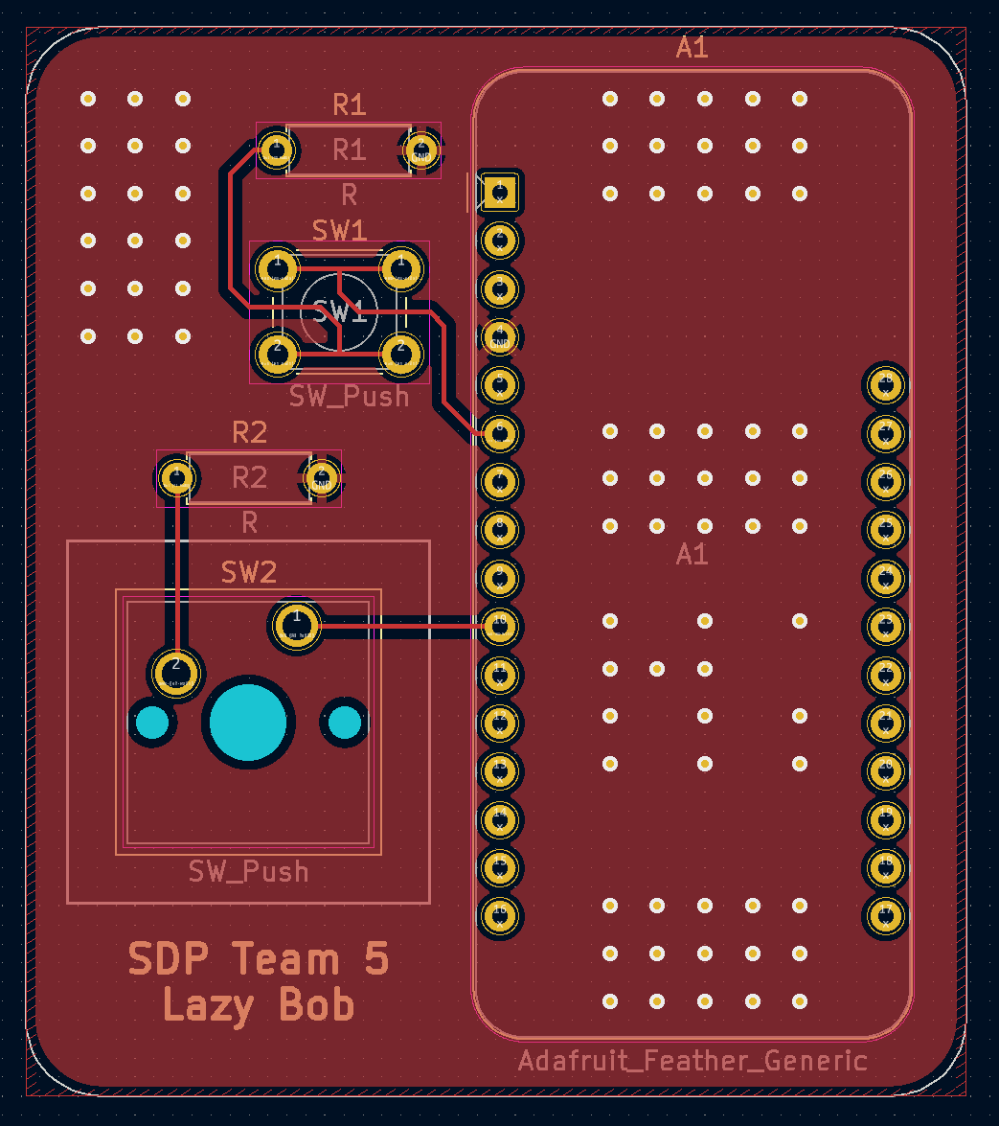
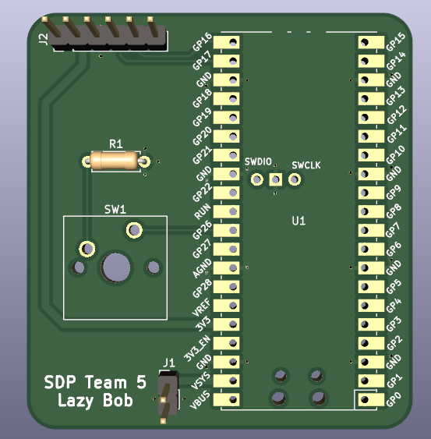
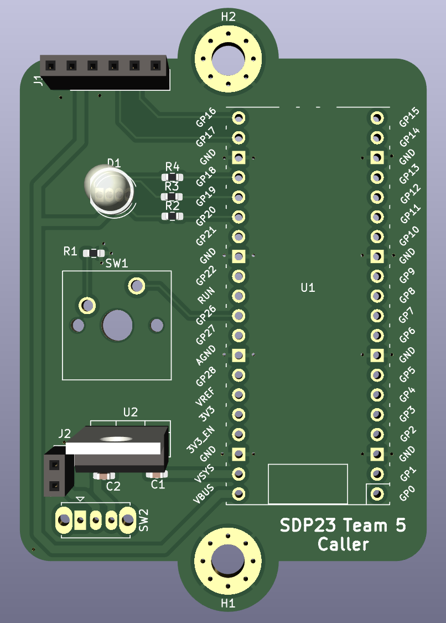
Subsystem: Caller PCB
MDR
CDR
FPR
Notes:
Gina
Move fpr part to later?

Slide 20
Sensors

Slide 21
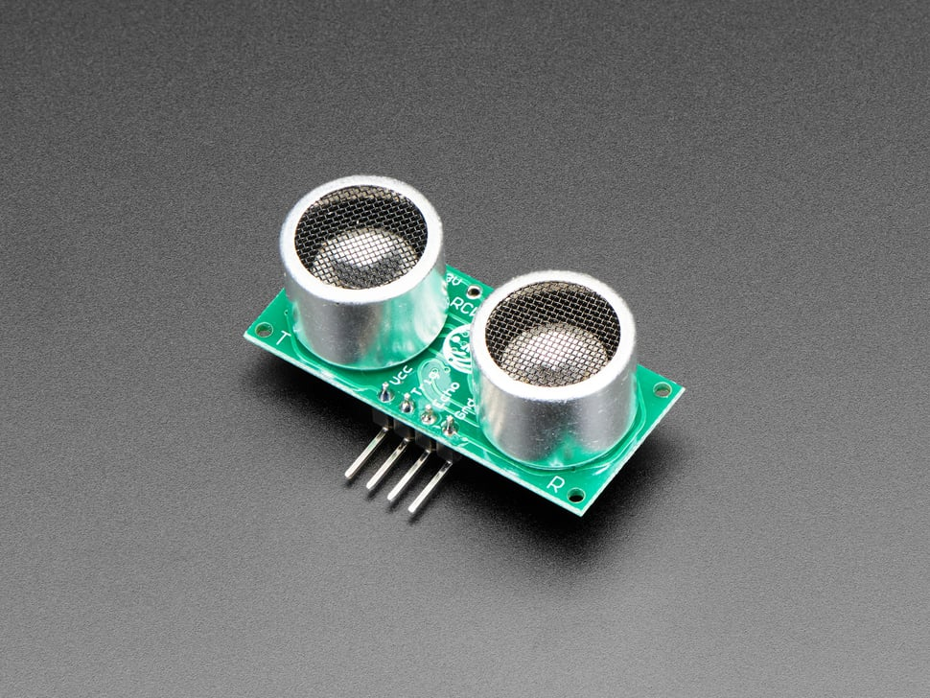
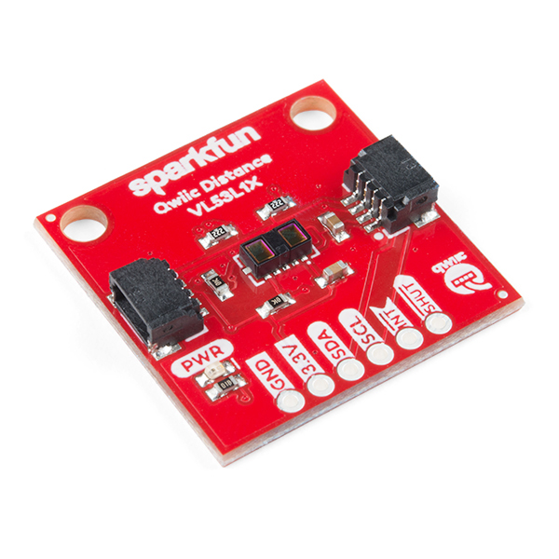
Subsystem: Collision and Cliff Detection
Ultrasonic
Collision detection (CDR)
Has not changed from before
Light ToF
Edge Detection (CDR)
Collision Detection (FPR)
Easy to implement many at a time
https://www.sparkfun.com/products/14722
Notes:
Soham
Finish cdr before moving on to fpr

Slide 22
Positioning and Rerouting

Slide 23
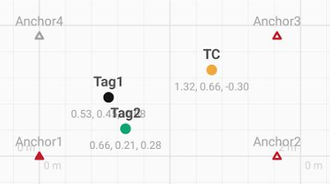
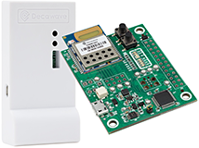
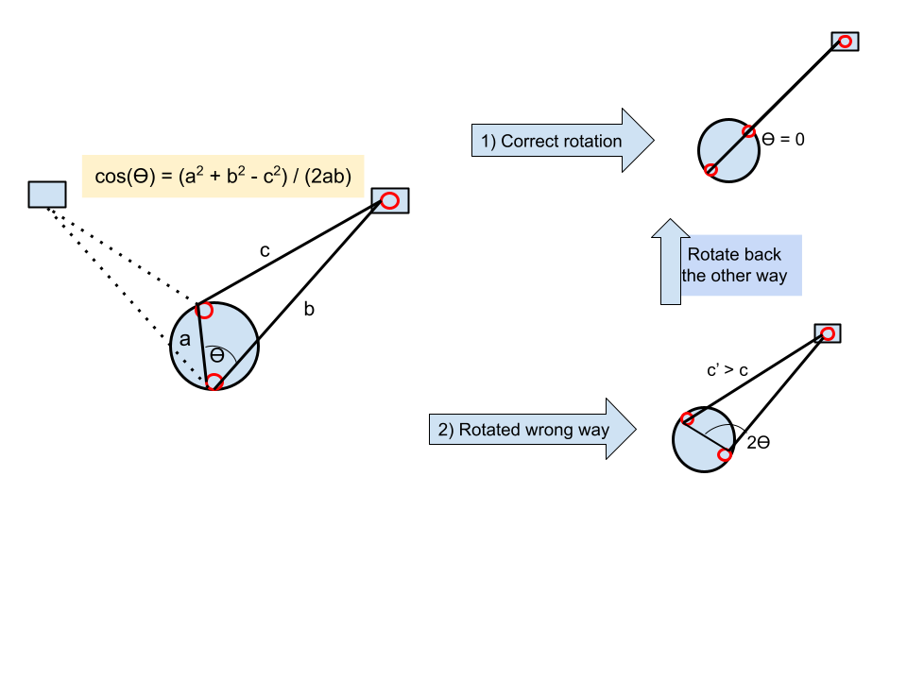
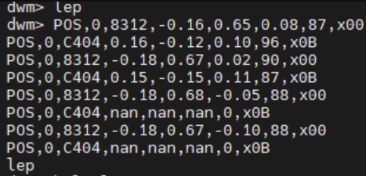
Subsystem: Positioning
Ultra Wideband Sensor
https://www.frontiersin.org/articles/10.3389/fnbot.2022.715440/full
https://www.qorvo.com/products/p/MDEK1001
Notes:
Redwan
For the positioning subsystem, we are still using the UWB sensors. The 4 anchor sensors are continually updating the locations of the 3 tags in use. It then plots it onto a coordinate grid like the one shown here and returns those coordinates to us. We take those coordinates and extract the theta we need to rotate and distance we travel. In the current implementation, we are only doing clockwise rotations and postponing the issue of clockwise vs counterclockwise till FPR. For FPR, we are planning to add a third tag onto the coaster itself which can easily tell us if the destination is to our right or left(cw or ccw).
Explain calibration - “we know” Anchors back in diagram
Fix diagram - very confusing - temporary solution, might not need to know right now? But might need to know more Show phone grid
Missing sense of ‘measuring angles continuously’
Reassessing constantly
Point out that it’s different from original design – now updates constantly

Slide 24
Rerouting Block Diagram
Notes:
Redwan
- The position updating and ultrasonic sensor happens in parallel Remove purple Reroute algo - stuff New block diagram?

Slide 25
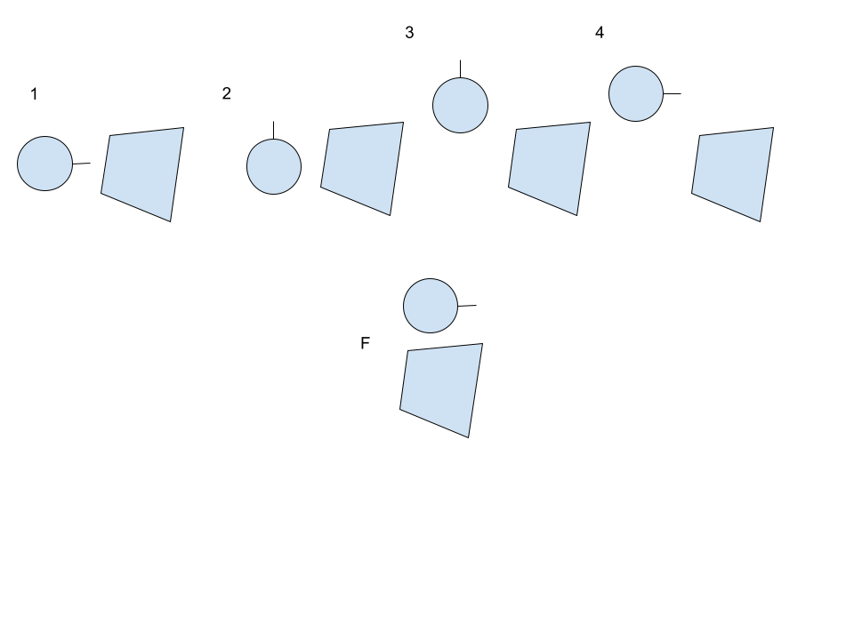
Subsystem: Algorithm
Current Iteration:
Brute Force Avoidance - Lazy Bob will back up, make a step to a side, then move forward again and check whether it has cleared the object. This will repeat if not TRUE.
Future Iteration:
Lazy Bob will fix two distances and trace its way around an object prioritizing the side with the most severe angle.
Notes:
Soham
Add sensor on side
Avoid fork/knife?

Slide 26
FPR Deliverables
Improved consistency on movement
Move movement controls to the coaster itself for better consistency
Better Rerouting Algorithm
Using more sensors, implement a better way to navigate
2nd Caller
4. Chassis for Coaster
a. 3D print chassis for each part
of the system
5. PCB Plans
a. Motion - Further optimizations
b. User input - Add 5V and LED
Notes:
Redwan

Slide 27
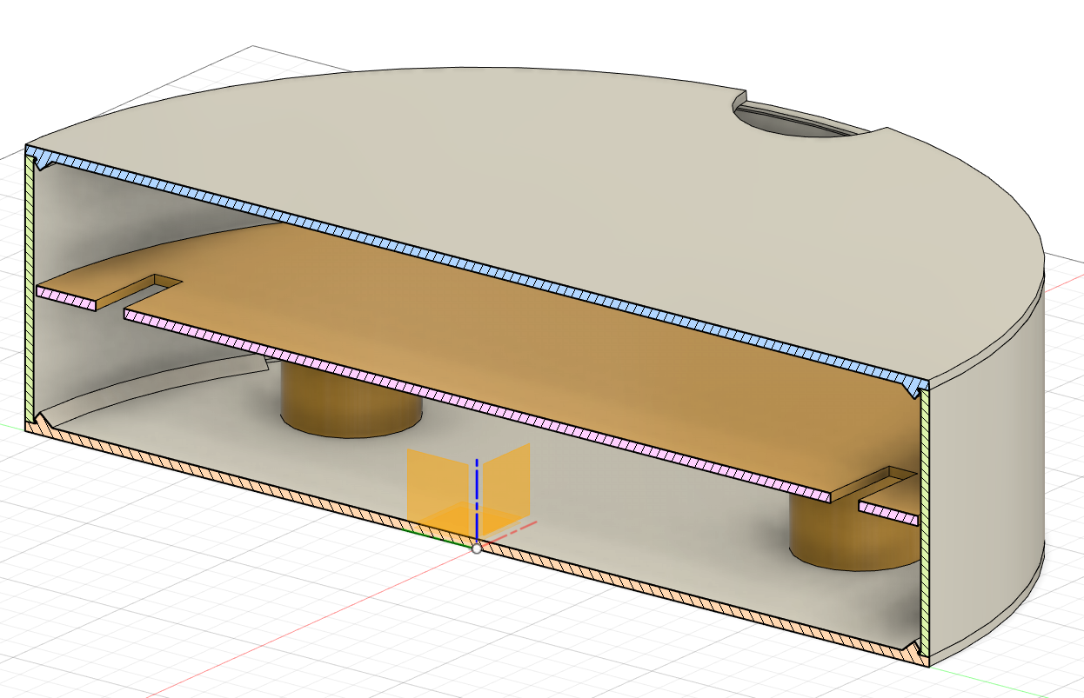
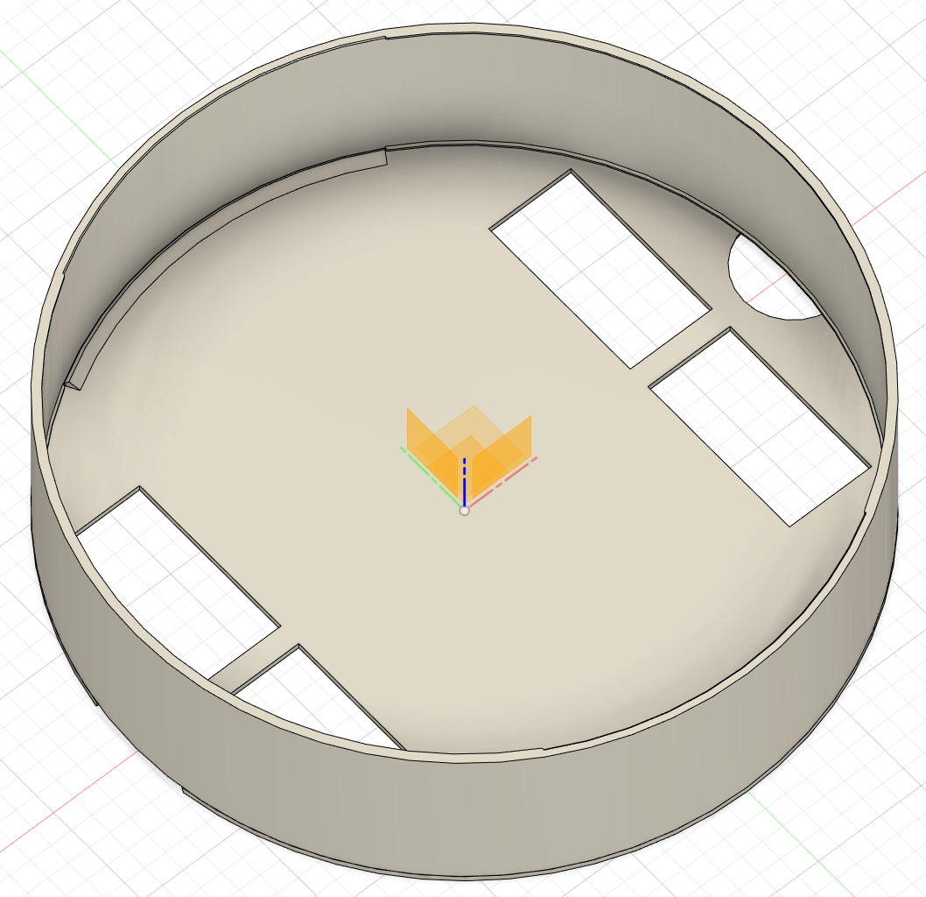
Design: Chassis (FPR)
Notes:
Gina
Move fpr stuff to later? - we can decide

Slide 28
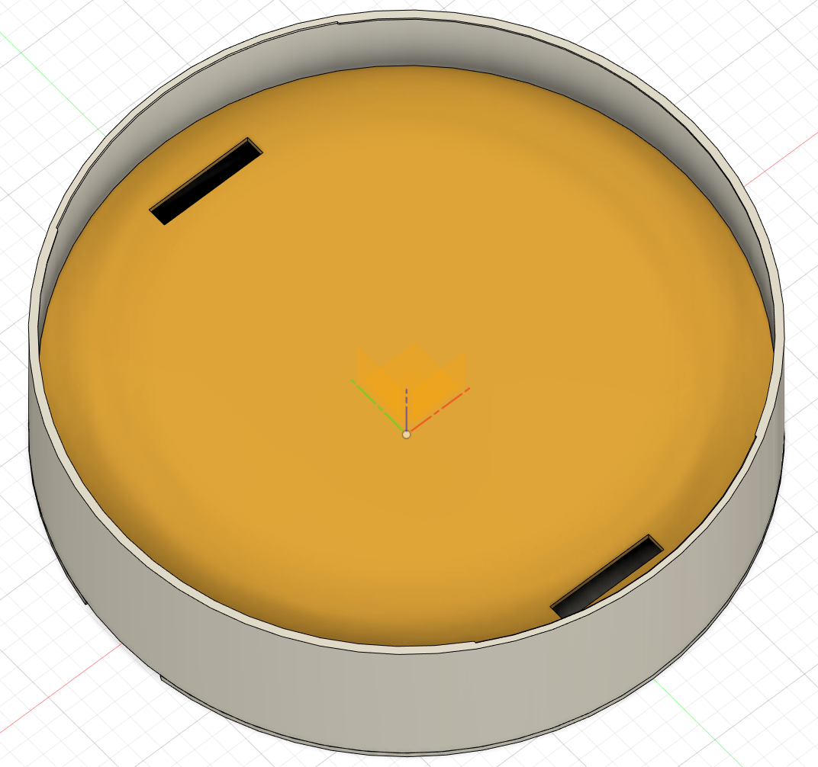
Design: Chassis (FPR)
Notes:
Gina

Slide 29
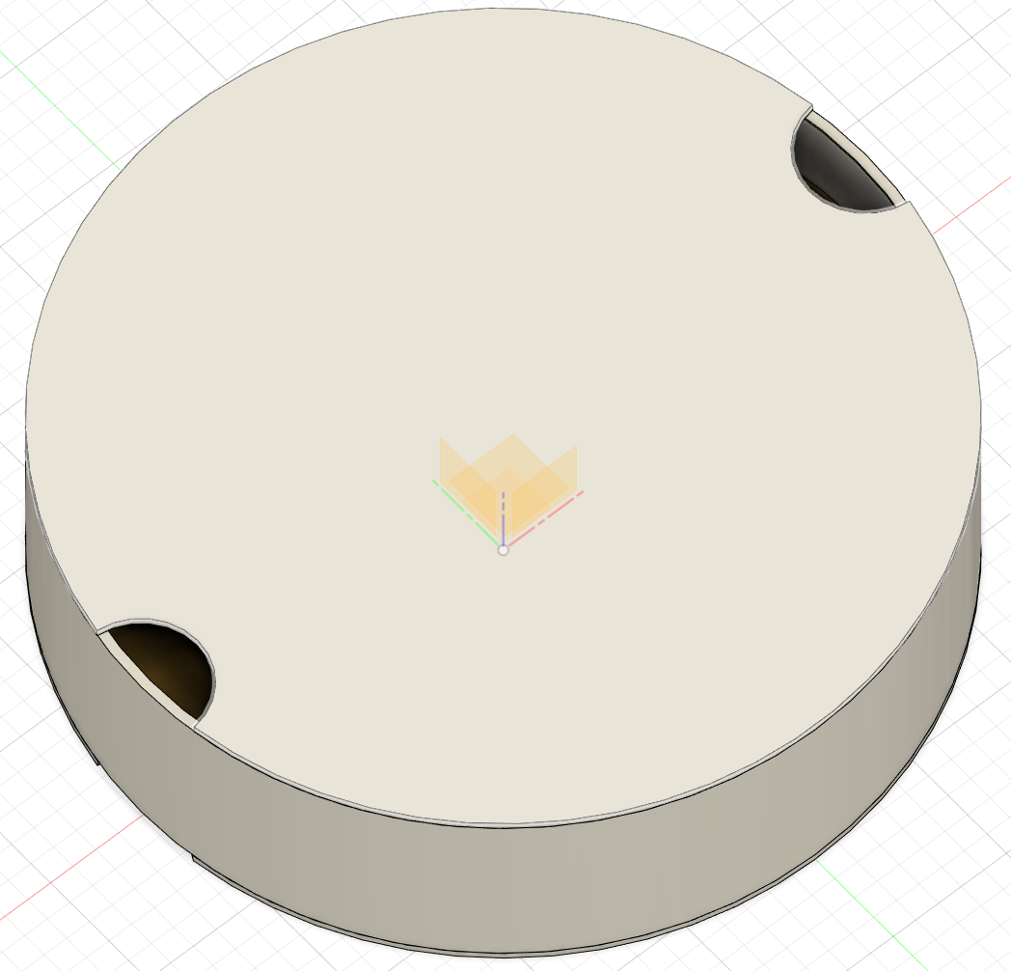
Design: Chassis (FPR)
Notes:
Gina

Slide 30
SDP Budget Used
Purchasing List
Item Name | Link | Price $ (w/Tax & Ship)
UWB DIY Starter Kit | Tindie | 74.98
2 x Pico W | Digikey | 12
Gina PCB1 | JLC | 22.05
Gina PCBs 2 | JLC | 15.44
Omar PCB1 | JLC | 6.5
Omar PCB2 | JLC | 6.76
6 Dof Sensors | Amazon | 15.95
10x HC05 | Amazon | 37.98
3D Filament | Amazon | 38.99
New Wheels | Adafruit | 28.17
$258.82
Notes:
Omar

Slide 31
Development Cost - per set of Brains, 1 Coaster, and 2 Callers
Coaster List
Item Name | Source | Price $ (with tax and shipping)
Qorvo UWB Kit | Qorvo | 170
3 x Pico W | Wouter | 18
PCBs | JLCPCB | 10
Sensors | M5 | 25
Sensors | M5 | 25
8x RCR132a | Amazon | 27
Motors and Wheels | Amazon | 50
Raspberry Pi 4 | M5 | 100
Misc. Hardware | Misc | 30
Lipo | M5 | 20
$475.00
Notes:
Omar Consider mass production - what would you spend on pcb, components, etc.

Slide 32
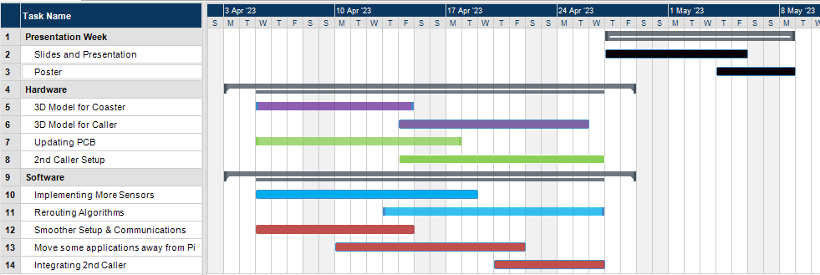
Gantt Chart
Notes:
Redwan
Break apart into little things

Slide 33
Videos
Straight Shot:
https://drive.google.com/file/d/141u86p3lzujfCnuI5bPtXzJ-QYSLi3L_/view?usp=sharing
Obstacle Avoidance:
https://drive.google.com/file/d/14BBHoazjFHobzXkXQCEPxUCetjSHFlHe/view?usp=sharing

Slide 34
QUESTIONS & ANSWERS

